Slide 1






SY 2025-2026
Title I Night
Parent/Community Meeting

Slide 2

Excellence
Community
Safety
Empathy
Innovation
Preparing students academically, socially, and emotionally for success today and tomorrow.

Slide 3

Excellence
Community
Safety
Empathy
Innovation
Preparing students academically, socially, and emotionally for success today and tomorrow.

Slide 4
Agenda
•Notice of Title I School Status & What is Title I?
•Perea School Family Engagement Plan and Policies (including MSCS Parent and Family Engagement Policy and Plan)
•Reporting Pupil Progress
•School’s Curriculum
•Parent Teacher Conferences
•Academic Assessment
•Parent Trainings-Opportunities for additional Parent Meetings
•School Progress/District Status/School Status (Standalone School)
•School Improvement Plan (SIP)
•Parent and Family Engagement Involvement
•Teacher Qualifications
•Parents’ Rights to Know
•School/Parent Compact
•Code of Conduct
•Parent Interest Survey
Excellence
Community
Safety
Empathy
Innovation
Preparing students academically, socially, and emotionally for success today and tomorrow.

Slide 5
Notice of Title I School Status
Perea is a Title I school that receives federal funding.
Being a Title I school means receiving federal funding (Title I dollars) to supplement the school’s existing programs. These dollars are used for…
Identifying students experiencing academic difficulties and providing timely assistance to help these student’s meet the State’s challenging content standards
Purchasing supplemental staff/programs/materials/supplies
Conducting parental involvement meetings/training/activities
Recruiting/Hiring/Retaining Highly Qualified Teachers
Excellence
Community
Safety
Empathy
Innovation
Thesis Defense
Preparing students academically, socially, and emotionally for success today and tomorrow.

Slide 6
Parent & Family Engagement Plan
Perea has established a plan the expectation for parental and family involvement. Our goal is to prepare parents and families to be knowledgeable of the skills and information needed to help their children to be successful in school, to establish the expectation for parental and family involvement, to build a partnership to help children achieve the State’s high standards and share the responsibility for improved student academic achievement. This plan has been jointly developed and agreed upon by Perea Elementary School parents, students, and school staff.
Parents’ involvement is vital to the success of our students.
The Schools of Perea has created a family engagement plan that reflects practices that enhance parent engagement and community involvement. MSCS also has a Family Engagement Plan and Policy which can be found on the scsk12.org website.
Excellence
Community
Safety
Empathy
Innovation
Thesis Defense
Preparing students academically, socially, and emotionally for success today and tomorrow.

Slide 7
Parent & Family Engagement Plan
This plan has been jointly developed and agreed upon by Perea Elementary School parents, students, and school staff.
This plan details activities to carry out Perea Elementary’s Family Engagement Plan in accordance with Memphis-Shelby County Schools’ Family Engagement Policy #7009.
A copy of this plan will be distributed to all parents in the school and community partners and posted on the school’s website in an understandable and uniform format, and to the extent practicable, provide it in a language that parents can understand. This plan is currently being implemented.
Excellence
Community
Safety
Empathy
Innovation
Thesis Defense
Preparing students academically, socially, and emotionally for success today and tomorrow.

Slide 8
Parent & Family Engagement Plan
Perea Elementary School pledges to eliminate barriers to parental and family involvement in the following ways:
1. Consistently acknowledge and greet parents and families in a friendly and welcoming manner, by all staff, when visiting the school.
2. Provide a flexible number of meetings at various times that allow all parents and families to participate.
3. Clarify terms using simple and direct language in a language that parents and families can understand.
4. Have written materials printed in English and Spanish.
5. Provide interpreter services when necessary.
6. Parents and families will be encouraged to express ideas, concerns, and suggestions and to receive a timely response.
7. Continue to have daily dialogue throughout the school to ensure success for all students (Staff and Support Staff).
8. Parents and families are provided an opportunity to communicate concerns/problems with the principal by submitting suggestions, concerns, comments, and problems on the school-wide program in the Parents’ Box located in the office and/or school website
Excellence
Community
Safety
Empathy
Innovation
Thesis Defense
Preparing students academically, socially, and emotionally for success today and tomorrow.

Slide 9
Parent & Family Engagement Plan
Perea Elementary will encourage parents and families to become meaningfully involved and promote the capacity for strong parental and family involvement in the following ways:
1. Opportunities for regular meetings for suggestions, decision-making, and responses will be held by encouraging parents and families to participate in the PTO, volunteer, attend Pastries for Parents, and Parent-Teacher Conferences. Parents and families will always be invited to Parent training sessions and other parental involvement activities.
2. The school will send home notices encouraging parents and families to attend and participate in conferences, workshops, and instructional activities to educate them on understanding topics such as: state academic content standards, state and local academic assessments, how to monitor a child’s progress, and working with educators to improve student achievement.
3. Conduct regular, flexible parent meetings, and parent requested meetings to keep parents and families informed of current events and issues, timely progress reports, and conduct parent/teacher conferences to discuss the child’s progress.
4. Parents and families will be invited to an Annual Meeting. The Annual Meeting will be held at flexible times and all parents and families will be invited. During this annual meeting, parents and families will be informed of their rights to be involved in their child’s education, informed of Title I policies and requirements, informed of parents right to know, and will be informed of Perea Elementary’s participation in the Title I program.
Excellence
Community
Safety
Empathy
Innovation
Thesis Defense
Preparing students academically, socially, and emotionally for success today and tomorrow.

Slide 10
Parent & Family Engagement Plan
5. Provide parents and families with training and materials to help them work with their child to improve achievement in literacy, mathematics, and the use of technology.
6. Provide timely information about parent and family programs via information board/marquee of current events with a monthly calendar and use of Classroom Dojo and Parent Square to inform parents and families of school activities; receive notices and communication timely, to respond and/or participate.
7. Provide a district and schoolwide Parent/Student Handbook covering school rules, policies, and procedures.
8. Jointly participate with parents and community volunteers in the development and revision of the Parent and Family Engagement Plan and the School Compact; receive a copy of both during the school year.
9. Utilize partnerships with community organizations, adopters, and businesses.
10. Utilize Parent Resources to coordinate and integrate parent and family involvement programs and activities.
11. Provide parents and families a description and/or explanation of the curriculum, assistance to help their child at home, forms of academic assessments used to measure student progress, information regarding the importance of weekly communication between the teacher and parent using the student communication folder, and proficiency levels students are expected to meet.
Excellence
Community
Safety
Empathy
Innovation
Thesis Defense
Preparing students academically, socially, and emotionally for success today and tomorrow.

Slide 11
Parent & Family Engagement Plan
12. Parents and families will be involved in an organized, ongoing, and timely way to plan, review, and evaluate the improvement of the school’s parental and family involvement policy and development of the school-wide programs, climate, and effectiveness.
13. Provide training, with the assistance of parents, for all stakeholders on the value and contributions of parents, strategies for working with parents, and how to reach out to, communicate with, and work with parents as equal partners, implement and coordinate parent programs, and build ties between parents and the school.
Excellence
Community
Safety
Empathy
Innovation
Thesis Defense
Preparing students academically, socially, and emotionally for success today and tomorrow.

Slide 12
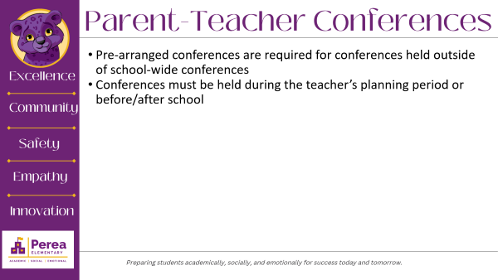
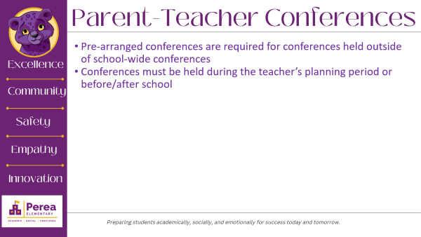
Reporting Pupil Progress
Report cards are issued to parents at the end of each grading period.
Grading Period 1: August 4th – October 3rd
Grading Period 2: October 6th – December 19th
Grading Period 3: January 5th – March 13th
Grading Period 4: March 23rd – May 21st
Progress Reports/Interims are issued to parents within the grading period.
Excellence
Community
Safety
Empathy
Innovation
Thesis Defense
Preparing students academically, socially, and emotionally for success today and tomorrow.

Slide 13
Curriculum
Math
  Eureka Math
  I-Ready
Science
  Great Minds
Social Studies
  Studies Weekly
Reading
  EL
  Reading Horizon
  Elevate
  Ditto
  I-Ready
Excellence
Community
Safety
Empathy
Innovation
Thesis Defense
Preparing students academically, socially, and emotionally for success today and tomorrow.

Slide 14
Parent-Teacher Conferences
Pre-arranged conferences are required for conferences held outside of school-wide conferences
Conferences must be held during the teacher’s planning period or before/after school
Excellence
Community
Safety
Empathy
Innovation
Thesis Defense
Preparing students academically, socially, and emotionally for success today and tomorrow.

Slide 15
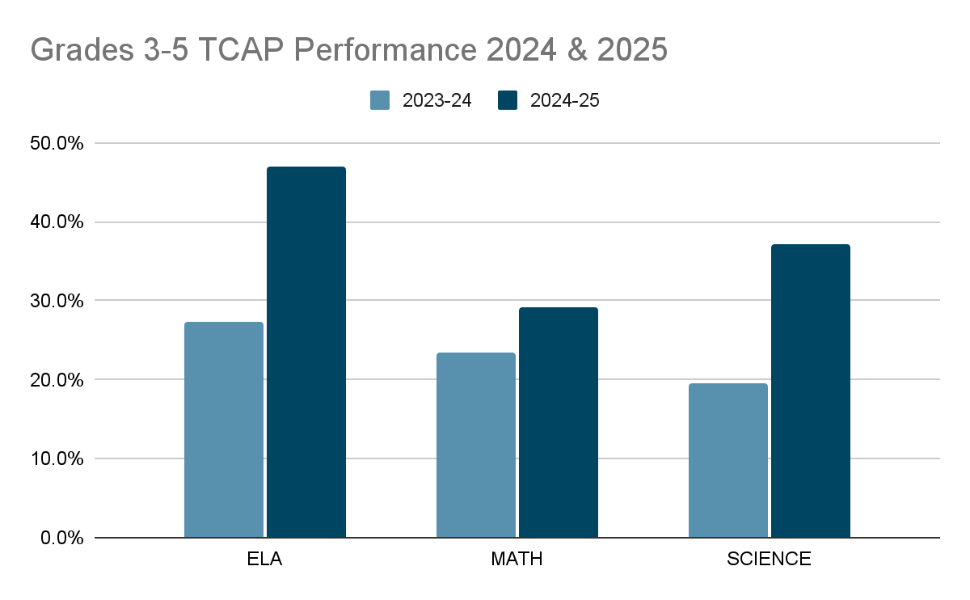

24-25 Data Results
What resonates with you about the data?
AMO Goals:
For the 2024-2025 school year, the Tennessee Department of Education assigned our school Annual Measurable Objective (AMO) targets. The AMO goals are set around the expected percentage of student mastery of grade-level standards based on the previous year’s assessment outcomes. We were charged with meeting the following goals for each content area.
Results
Excellence
Community
Safety
Subject (Grades 3-5) | Actual 24-25 | Double AMO Goals 24-25 | Actual 23-24
English Language Arts | 47% | 36.4% | 27.3%
Math | 29.1% | 33% | 23.4%
Science | 37.1% | 29.6% | 19.5%
Empathy
Innovation
Thesis Defense

Slide 16

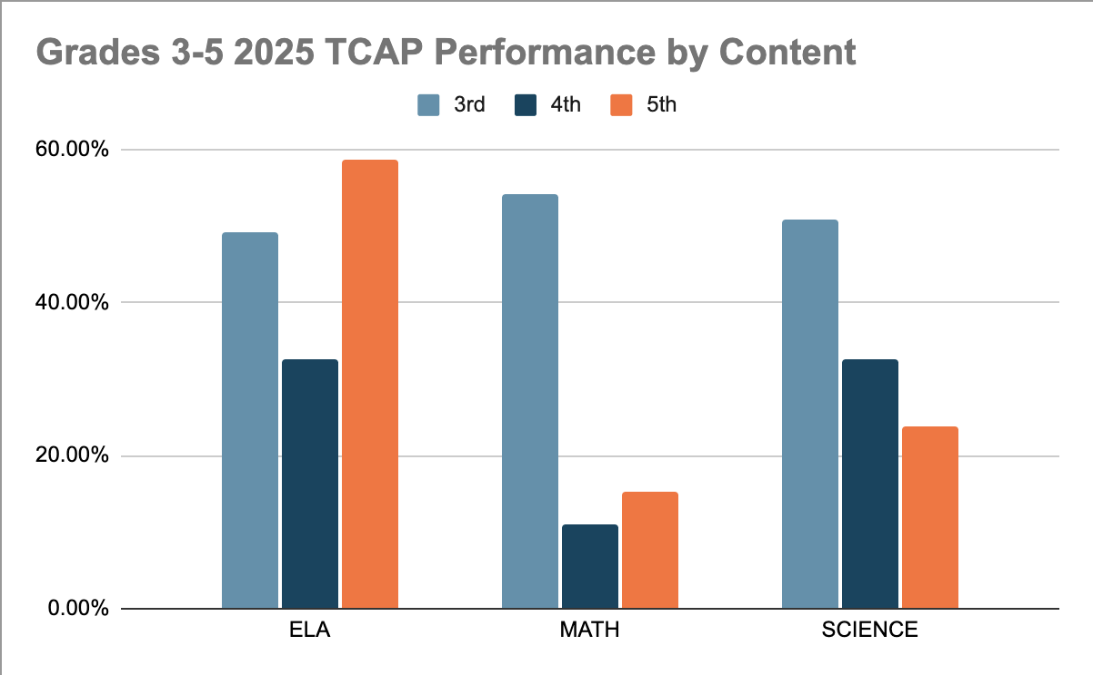
Grade-Level Academic Progress
Excellence
Art And Design '50 Year 2023
Community
Safety
Empathy
Innovation
Thesis Defense

Slide 17
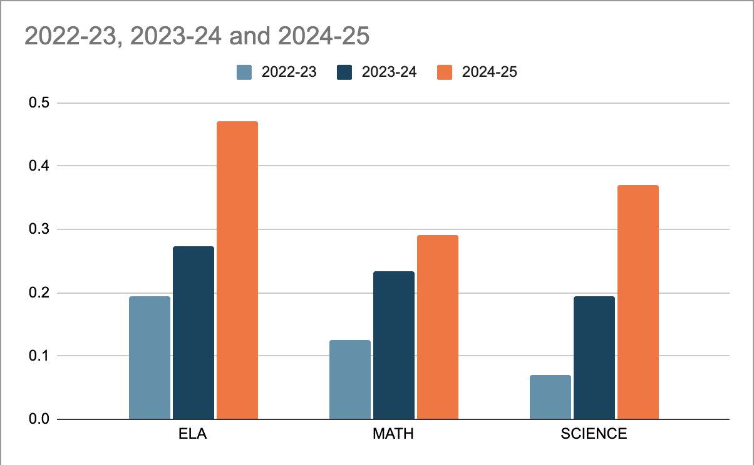
3-Year TCAP Trends by Content
Excellence
Art And Design '50 Year 2023
Community
Safety
Empathy
Innovation
Thesis Defense

Slide 18
Goals 24.25
Results
Excellence
Art And Design '50 Year 2023
Subject | Actual 23.24 | AMO Goals 24.25
English Language Arts | 27.2.% | 35%
Math | 23.8% | 32%
Science | 19.2% | 28%
Community
Safety
Empathy
Innovation
Thesis Defense

Slide 19
Additional Parent and Family Engagement Meeting Opportunities
The following events already have tentative dates. Additional opportunities will be communicated.​
Open House- August 2025
Grandparents’ Day- September 2025
Math and Science Night- November 2025
Family Data Night- December 2025
Honors Day Program- TBA
Optional Schools Fair- TBA
Literacy Night- March 2025
Career Day- TBA
Honors Day Program-TBA
**Notices will be sent home in advance so please check you child folder daily for school communication**
Results
Excellence
Art And Design '50 Year 2023
Community
Safety
Empathy
Innovation
Thesis Defense

Slide 20
Perea’s District Status
Results
Schools of Perea is a standalone charter school and receives Title I funding through MSCS.
Excellence
Art And Design '50 Year 2023
Community
Safety
Empathy
Innovation
Thesis Defense

Slide 21
School Improvement Plan
In order for the state of Tennessee to reach its goals, the state, districts, and schools must develop plans for improvement.
Each year schools, including Perea, create a comprehensive School Improvement Plan (SIP) that is developed by the school admin, teachers, parents, and additional stakeholders.
Stakeholders are challenged to review data to identify the current needs of the school. Once the needs are identified, the SIP team creates aligned goals, strategies, and action steps that correspond to the prioritized needs.
Plans are continuously monitored, and revisions are made based on students’ needs throughout the school year.
Results
Excellence
Art And Design '50 Year 2023
Community
Safety
Empathy
Innovation
Thesis Defense

Slide 22
Teacher Qualifications
The Elementary and Secondary Education Act gives the parents and guardians of children attending a school that receives Title I funding, the right to know the qualifications of your child’s teacher(s).
It is our intent to provide each student at Perea Elementary School with teachers and paraprofessionals that are highly qualified.
As required by federal law, all teachers in Title I schools must have a minimum of a bachelor’s degree and have demonstrated highly qualified competency in the academic subjects they teacher.
New hired paraprofessionals must also meet rigorous requirements set forth for them by the State of Tennessee as well.
Excellence
Community
Safety
Empathy
Innovation
Thesis Defense
Preparing students academically, socially, and emotionally for success today and tomorrow.

Slide 23
Parents Right To Know
All parents have the right to request the following:
  A teacher’s professional qualifications licensure, grade(s) certification, waivers
  A teacher’s baccalaureate and/or graduate degree, fields of endorsement, previous teaching experience
  A paraprofessional’s qualifications
  An annual notice of Student Education Records Privacy and notice for disclosure of School Directory Information
  An assurance that their child’s name, address and telephone listing not be released to military recruiters.
Excellence
Community
Safety
Empathy
Innovation
Thesis Defense
Preparing students academically, socially, and emotionally for success today and tomorrow.

Slide 24
Parents Right To Know
All parents will receive information on the following:
  Their child’s level of achievement on each of the state’s academic assessments
  Notification of the right to transfer the child to another school in the district if the student becomes a victim of a violent crime or is assigned to an unsafe school.
  District Family Involvement Policy and School Parent Involvement Policy
  In the event of an unlicensed teacher on permit teaching the children for 4 or more consecutive weeks, the parent will be notified.
Excellence
Community
Safety
Empathy
Innovation
Thesis Defense
Preparing students academically, socially, and emotionally for success today and tomorrow.

Slide 25
School/Parent Compact
Excellence
School/Parent Compact
The compact is a commitment from the school, the parent, and the student to share in the responsibility for improved academic achievement
You, as Title I Parents, have the right to be involved in the development of the School-Parent Compact.
After all signatures have been gathered, the compacts will be located in my office.
Community
Safety
Empathy
Innovation
Thesis Defense
Preparing students academically, socially, and emotionally for success today and tomorrow.

Slide 26
Student Code of Conduct
Examples of Unacceptable Behaviors
Physical touching of another person with or without the intent to cause injury
Fighting
Bullying (include cyberbullying)
Posing a physical threat to oneself or others (banging head, making a threat)
Possession of a weapon, drugs or alcohol
Coming to school or any school activity under the influence of alcohol, drugs, or other foreign substance
Refusal to stay within the teacher’s site
Verbal harassment of a teacher (cursing, name calling, or mocking)
Use of profanity
Tantrum at a volume that inhibits the flow of the class
Destruction of property
Theft
Sexual touching, language, gestures, or actions with cause injury, fear, and/or emotional harm to another person, with or without the use of force.
Excellence
Community
Safety
Empathy
Innovation
Thesis Defense
Preparing students academically, socially, and emotionally for success today and tomorrow.

Slide 27
School Uniform
Dress Code
Uniforms are mandatory for each child. The uniform is dark blue, black, or khaki bottoms and a yellow or purple polo shirt with or without the SoP logo. Polo shirts are required Monday-Thursday. School t-shirts are allowed on Friday ONLY. All shirts must be tucked in. Denim wear is not acceptable. Earrings and sagging pants are not acceptable. Walking shorts are permitted (these are straight shorts that come to the knee).
No sandals
No earrings
No shorts 6 inches above the knee
Excellence
Community
Safety
Empathy
Innovation
Thesis Defense
Preparing students academically, socially, and emotionally for success today and tomorrow.

Slide 28
Student Expectations
Be on Time & Have Supplies for Class
Follow Rules, Procedures, Dress Code
Complete Assignments
Return Wednesday Folder by Thursday
Maintain Homework Binder
Make-Up Work Done in Timely Manner
Give Notes/Money to Teacher
(List anything you expect students to do)
Excellence
Community
Safety
Empathy
Innovation
Thesis Defense
Preparing students academically, socially, and emotionally for success today and tomorrow.

Slide 29

Questions
Excellence
Community
Safety
Empathy
Innovation
Thesis Defense
Preparing students academically, socially, and emotionally for success today and tomorrow.

