Slide 1






Title I Night
&
Meet The Teacher Night

Slide 2

Excellence
Community
Safety
Empathy
Innovation
Preparing students academically, socially, and emotionally for success today and tomorrow.

Slide 3
Agenda
Introduction of Teachers
What is Title I?
Perea’s Current Data
Teacher Qualifications
Reporting Pupil Progress
Parents’ Rights to Know
Parental Involvement
School/Parent Compact
Student Code of Conduct
School’s Instructional Curriculum
Uniform
Student Expectations
Communication
Parent Interest Survey
Excellence
Community
Safety
Empathy
Innovation
Preparing students academically, socially, and emotionally for success today and tomorrow.

Slide 4

Excellence
Community
Safety
Empathy
Innovation
Preparing students academically, socially, and emotionally for success today and tomorrow.

Slide 5
Goal’ for Title I and Meet the Teacher
Excellence
  To help parents understand the work their child will be doing throughout the school year
  To explain our expectations of your child
  To share information about how parents can support their child’s learning
  Build rapport between teachers and parents
Community
Safety
Empathy
Innovation
Preparing students academically, socially, and emotionally for success today and tomorrow.

Slide 6

Introduction of KK Teachers
Mrs. D. Harrion Ms. Timerea
Mrs. R. Bradley Mrs. Phillips
Ms. C. Robinson Ms. D. Harvey
Ms. Thompson Ms. Mallory
Excellence
Community
Safety
Empathy
Innovation
Preparing students academically, socially, and emotionally for success today and tomorrow.

Slide 7

Introduction of 1st Grade Teachers
Mrs. C. Brown Ms. A. Coleman
Mrs. L. Shaw Ms. B. Jamerson
Ms. C. Robinson Ms. D. Harvey
Ms. Thompson Ms. Mallory
Excellence
Community
Safety
Empathy
Innovation
Preparing students academically, socially, and emotionally for success today and tomorrow.

Slide 8

Introduction of 2nd Grade Teachers
Mr. K. Sanders Mrs. Spears
Mrs. J. Davis Ms. Yarbrough
Ms. K. Carpenter
Excellence
Community
Safety
Empathy
Innovation
Preparing students academically, socially, and emotionally for success today and tomorrow.

Slide 9
Introduction of 3rd Grade Teachers
Mr. J. McGee Ms. Giles
Mrs. K. Quinney
Mrs. T. Kuykendoll
Excellence
Community
Safety
Empathy
Innovation
Preparing students academically, socially, and emotionally for success today and tomorrow.

Slide 10
Introduction of 4th Grade Teachers
Mr. G. Sing
Mrs. T. Coleman
Ms. C. Weeks
Excellence
Community
Safety
Empathy
Innovation
Preparing students academically, socially, and emotionally for success today and tomorrow.

Slide 11
Introduction of 5th Grade Teachers
Mrs. M. Everret
Mr. T. Hughes
Ms. T. Green
Excellence
Community
Safety
Empathy
Innovation
Preparing students academically, socially, and emotionally for success today and tomorrow.

Slide 12
What is Title 1?
Being a Title I school means receiving federal funding (Title I dollars) to supplement the school’s existing programs. These dollars are used for…
Identifying students experiencing academic difficulties and providing timely assistance to help these student’s meet the State’s challenging content standards
Purchasing supplemental staff/programs/materials/supplies
Conducting parental involvement meetings/training/activities
Recruiting/Hiring/Retaining Highly Qualified Teachers
Excellence
Community
Safety
Empathy
Innovation
Thesis Defense
Preparing students academically, socially, and emotionally for success today and tomorrow.

Slide 13
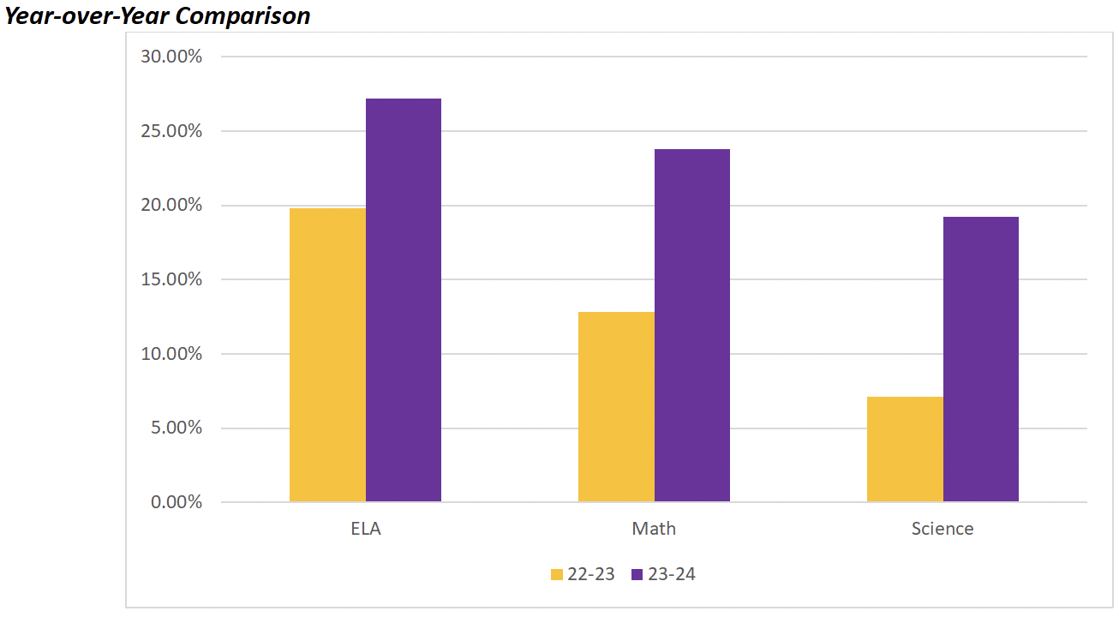
23-24 Data Results
AMO Goals:
For the 2023-2024 school year, the Tennessee Department of Education assigned our school Annual Measurable Objective (AMO) targets. The AMO goals are set around the expected percentage of student mastery of grade-level standards based on the previous year’s assessment outcomes. We were charged with meeting the following goals for each content area.
Results
Excellence
Art And Design '50 Year 2023
Community
Safety
Subject | AMO Goals | Double AMO Goals
English Language Arts | 24.6% | 29.6%
Math | 18.1% | 23.6%
Science | 12.8% | 18.6%
Empathy
Innovation
Thesis Defense

Slide 14
Teacher Qualifications
The Elementary and Secondary Education Act gives the parents and guardians of children attending a school that receives Title I funding, the right to know the qualifications of your child’s teacher(s).
It is our intent to provide each student at Perea Elementary School with teachers and paraprofessionals that are highly qualified.
As required by federal law, all teachers in Title I schools must have a minimum of a bachelor’s degree and have demonstrated highly qualified competency in the academic subjects they teacher.
New hired paraprofessionals must also meet rigorous requirements set forth for them by the State of Tennessee as well.
Excellence
Community
Safety
Empathy
Innovation
Thesis Defense
Preparing students academically, socially, and emotionally for success today and tomorrow.

Slide 15
Reporting Pupil Progress
Excellence
Report cards are issued to parents at the end of each grading period.
Grading Period 1: August 7th – October 6th 4
Grading Period 2: October 17th – December 22nd
Grading Period 3: January 8th – March 8th
Grading Period 4: March 19th – May 22th
Progress Reports/Interims are issued to parents within the grading period.
Community
Safety
Empathy
Innovation
Thesis Defense
Preparing students academically, socially, and emotionally for success today and tomorrow.

Slide 16
Parents Right To Know
All parents have the right to request the following:
  A teacher’s professional qualifications licensure, grade(s) certification, waivers
  A teacher’s baccalaureate and/or graduate degree, fields of endorsement, previous teaching experience
  A paraprofessional’s qualifications
  An annual notice of Student Education Records Privacy and notice for disclosure of School Directory Information
  An assurance that their child’s name, address and telephone listing not be released to military recruiters.
Excellence
Community
Safety
Empathy
Innovation
Thesis Defense
Preparing students academically, socially, and emotionally for success today and tomorrow.

Slide 17
Parents Right To Know
All parents will receive information on the following:
  Their child’s level of achievement on each of the state’s academic assessments
  Notification of the right to transfer the child to another school in the district if the student becomes a victim of a violent crime or is assigned to an unsafe school.
  District Family Involvement Policy and School Parent Involvement Policy
Excellence
Community
Safety
Empathy
Innovation
Thesis Defense
Preparing students academically, socially, and emotionally for success today and tomorrow.

Slide 18
Parental Involvement Plan
The Schools of Perea will develop a culture for Perea families to collaborate and work together as one system that encourages families to learn from each other as individuals and in groups, invite community partnerships to share education and career experiences with families, and provide opportunities for continued participation and involvement.
Parents’ involvement is vital to the success of our students. Research shows that parent involvement enhances student self-esteem, increases academic achievement and cognitive development, and improves student behavior and attendance. The Schools of Perea has created a family engagement plan that reflects practices that enhance parent engagement and community involvement.
Excellence
Community
Safety
Empathy
Innovation
Thesis Defense
Preparing students academically, socially, and emotionally for success today and tomorrow.

Slide 19
Parental Involvement Plan
Facilitate family cohesion and school belonging
Strategies include:
Schools of Perea will provide an onsite Parent Resource Center with resources to promote self-sufficiency, student achievement, counseling, and supportive services.
Families will engage in a battery of assessments to develop and accomplish identified goals for their child and family.
Family Coaches, Sr. Director of Family and Community Engagement, and Community Partners will support families with workshops to enhance skill levels of adults, parenting skills, and share information regarding available programs.
The Family Engagement Team will participate in the home visit program to support family and academic goals.
Family and Community Engagement events will be provided monthly to families to increase family involvement and school culture.
Excellence
Community
Safety
Empathy
Innovation
Thesis Defense
Preparing students academically, socially, and emotionally for success today and tomorrow.

Slide 20
Parental Involvement Plan
2. Establishes a network of community resources
Strategies include:
Building partnerships with community and technical colleges such as Southwest Community College, TCAT-Memphis, and Arkansas State University-Mid-South.
Maintaining a relationship with city-wide organizations to enhance adult and child learning.
Informing families of diverse resources and outreach programs; including organizations that promote learning and well-being.
Linking families with support services, peer-to-peer groups, and various resources aligned with family needs.
The Family Engagement Team will ensure families are aware of services and their rights under federal and state laws.
Excellence
Community
Safety
Empathy
Innovation
Thesis Defense
Preparing students academically, socially, and emotionally for success today and tomorrow.

Slide 21
Parental Involvement Plan
3. Increase family participation in decision-making
Strategies include:
Closing participation gaps for the Family Advisory Board to increase parent/teacher relationships and school culture.
Families sharing their opinions regarding campus climate, future programs, family needs, and the SOP Family and Community Engagement Program by completing annual and bi-annual surveys.
Excellence
Community
Safety
Empathy
Innovation
Thesis Defense
Preparing students academically, socially, and emotionally for success today and tomorrow.

Slide 22
Parental Involvement Plan
4. Develop staff skills in evidence-based practices that support families in meeting their children’s learning benchmarks
Strategies include:
Ongoing professional development for all staff members in the area(s) of cultural responsiveness, academic partnership, trauma-informed parenting, and family engagement.
Providing knowledge based on the importance of family engagement.
Providing professional development that focuses on crucial conversations with families.
Additional professional development to include de-escalation skills, dealing with families in crisis, confidentiality, etc.
Gaining an understanding of early intervention services to support family inquiries and needs.
Excellence
Community
Safety
Empathy
Innovation
Thesis Defense
Preparing students academically, socially, and emotionally for success today and tomorrow.

Slide 23
School/Parent Compact
Excellence
School/Parent Compact
The compact is a commitment from the school, the parent, and the student to share in the responsibility for improved academic achievement
You, as Title I Parents, have the right to be involved in the development of the School-Parent Compact.
After all signatures have been gathered, the compacts will be located in my office.
Community
Safety
Empathy
Innovation
Thesis Defense
Preparing students academically, socially, and emotionally for success today and tomorrow.

Slide 24
Student Code of Conduct
Examples of Unacceptable Behaviors
Physical touching of another person with or without the intent to cause injury
Fighting
Bullying (include cyberbullying)
Posing a physical threat to oneself or others (banging head, making a threat)
Possession of a weapon, drugs or alcohol
Coming to school or any school activity under the influence of alcohol, drugs, or other foreign substance
Refusal to stay within the teacher’s site
Verbal harassment of a teacher (cursing, name calling, or mocking)
Use of profanity
Tantrum at a volume that inhibits the flow of the class
Destruction of property
Theft
Sexual touching, language, gestures, or actions with cause injury, fear, and/or emotional harm to another person, with or without the use of force.
Excellence
Community
Safety
Empathy
Innovation
Thesis Defense
Preparing students academically, socially, and emotionally for success today and tomorrow.

Slide 25
Curriculum
Math
  Eureka Math
  I-Ready
Science
  Great Minds
Social Studies
  Studies Weekly
Reading
  EL
  Reading Horizon
  Elevate
  Ditto
  I-Ready
Excellence
Community
Safety
Empathy
Innovation
Thesis Defense
Preparing students academically, socially, and emotionally for success today and tomorrow.

Slide 26
School Uniform
Dress Code
Uniforms are mandatory for each child. The uniform is dark blue, black, or khaki bottoms and a yellow or purple polo shirt with or without the SoP logo. Polo shirts are required Monday-Thursday. School t-shirts are allowed on Friday ONLY. All shirts must be tucked in. Denim wear is not acceptable. Earrings and sagging pants are not acceptable. Walking shorts are permitted (these are straight shorts that come to the knee).
No sandals
No earrings
No shorts 6 inches above the knee
Excellence
Community
Safety
Empathy
Innovation
Thesis Defense
Preparing students academically, socially, and emotionally for success today and tomorrow.

Slide 27
Student Expectations
Be on Time & Have Supplies for Class
Follow Rules, Procedures, Dress Code
Complete Assignments
Return Wednesday Folder by Thursday
Maintain Homework Binder
Make-Up Work Done in Timely Manner
Give Notes/Money to Teacher
(List anything you expect students to do)
Excellence
Community
Safety
Empathy
Innovation
Thesis Defense
Preparing students academically, socially, and emotionally for success today and tomorrow.

Slide 28
Communications
Pre-arranged conferences are required for conferences held outside of school-wide conferences
Conferences must be held during the teacher’s planning period or before/after school
Excellence
Community
Safety
Empathy
Innovation
Thesis Defense
Preparing students academically, socially, and emotionally for success today and tomorrow.

Slide 29

Questions
Excellence
Community
Safety
Empathy
Innovation
Thesis Defense
Preparing students academically, socially, and emotionally for success today and tomorrow.

Slide 30
Questions
Excellence
Art And Design '50 Year 2023
Community
Safety
Empathy
Innovation
Thesis Defense

